Slide 1
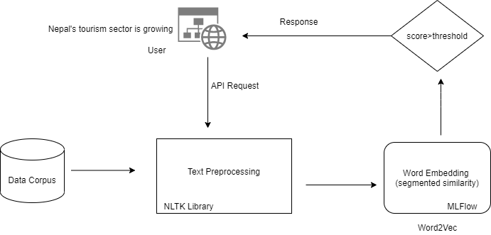
Workflow chart for Similar sentence Recommendation system

Slide 2
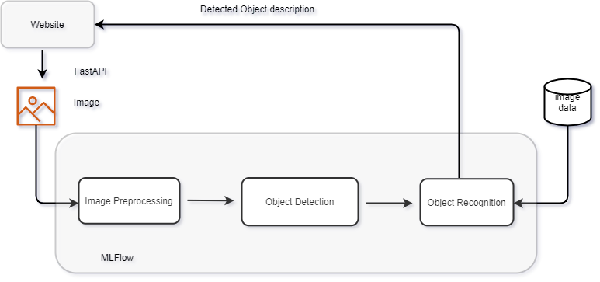
Workflow chart for Object Detection

Slide 3
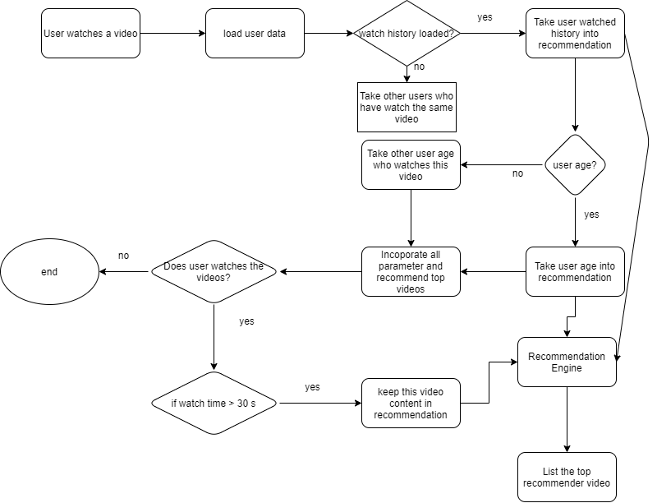
Workflow chart for Video recommendation system like youtube

Slide 4
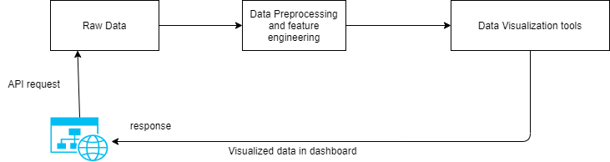
Workflow chart for Data visualization project for ABC-office data

